Slide 1
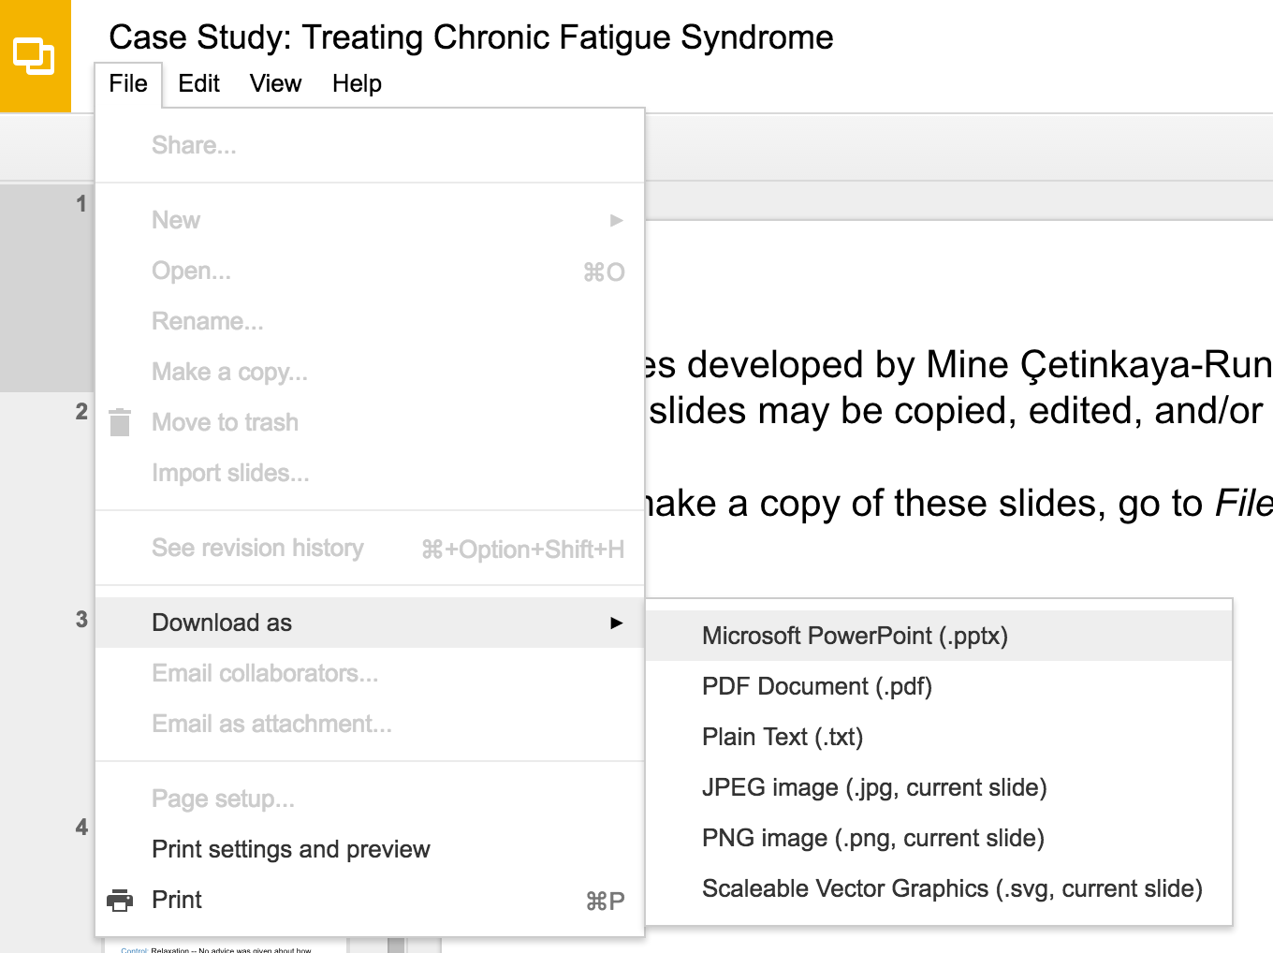
Slides developed by Mine Çetinkaya-Rundel of OpenIntro
Translated from LaTeX to Google Slides by Curry W. Hilton of OpenIntro.
The slides may be copied, edited, and/or shared via the CC BY-SA license
To make a copy of these slides, go to File > Download as > [option], as shown below. Or if you are logged into a Google account, you can choose Make a copy... to create your own version in Google Drive.

Slide 2
Paired Data
Slides developed by Mine Çetinkaya-Rundel of OpenIntro
Translated from LaTeX to Google Slides by Curry W. Hilton of OpenIntro.
The slides may be copied, edited, and/or shared via the CC BY-SA license
Some images may be included under fair use guidelines (educational purposes)

Slide 3
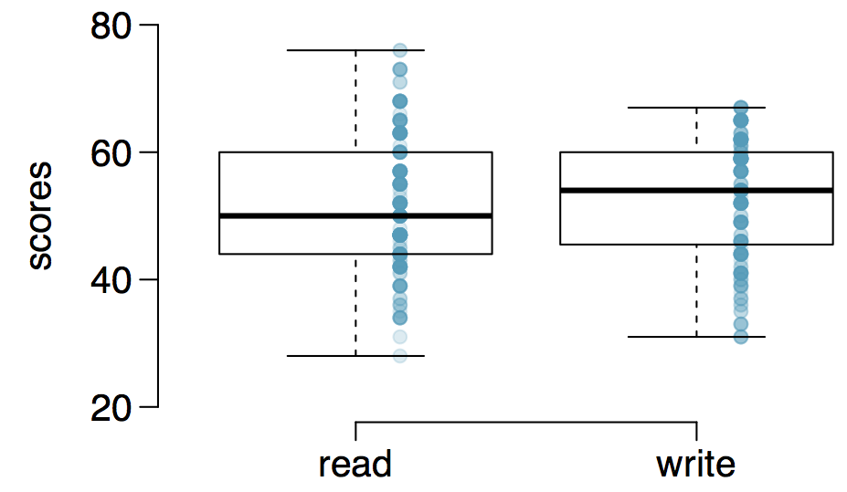
Paired observations
200 observations were randomly sampled from the High School and Beyond survey. The same students took a reading and writing test and their scores are shown below. At a first glance, does there appear to be a difference between the average reading and writing test score?

Slide 4
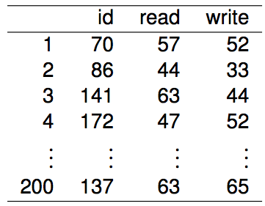
Paired observations
The same students took a reading and writing test and their scores are shown below. Are the reading and writing scores of each student independent of each other?
(a) Yes (b) No

Slide 5
Paired observations
The same students took a reading and writing test and their scores are shown below. Are the reading and writing scores of each student independent of each other?
(a) Yes (b) No

Slide 6
Analyzing paired data
When two sets of observations have this special correspondence (not independent), they are said to be paired

Slide 7
Analyzing paired data
When two sets of observations have this special correspondence (not independent), they are said to be paired
To analyze paired data, it is often useful to look at the difference in outcomes of each pair of observations
diff = read - write

Slide 8
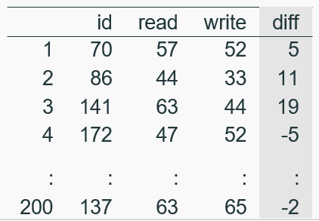
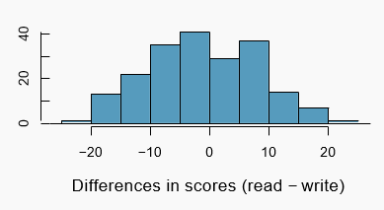
Analyzing paired data
When two sets of observations have this special correspondence (not independent), they are said to be paired
To analyze paired data, it is often useful to look at the difference in outcomes of each pair of observations
diff = read - write
It is important that we always subtract using a consistent order

Slide 9

Parameter and point estimate
Parameter of interest: Average difference between the reading and writing scores of all high school students

Slide 10

Parameter and point estimate
Parameter of interest: Average difference between the reading and writing scores of all high school students
Point estimate: Average difference between the reading and writing scores of sampled high school students

Slide 11
Setting the hypotheses
If in fact there was no difference between the scores on the reading and writing exams, what would you expect the average difference to be?

Slide 12
Setting the hypotheses
If in fact there was no difference between the scores on the reading and writing exams, what would you expect the average difference to be?
0

Slide 13
Setting the hypotheses
If in fact there was no difference between the scores on the reading and writing exams, what would you expect the average difference to be?
0
What are the hypotheses for testing if there is a difference between the average reading and writing scores?

Slide 14


Setting the hypotheses
If in fact there was no difference between the scores on the reading and writing exams, what would you expect the average difference to be?
0
What are the hypotheses for testing if there is a difference between the average reading and writing scores?
H₀ : Average traffic flow on Friday 6th and 13th are equal.
H_{A} : Average traffic flow on Friday 6th and 13th are different.

Slide 15
Nothing new here
The analysis is no different than what we have done before
We have data from one sample: differences.
We are testing to see if the average difference is different than 0.

Slide 16
Checking assumptions & conditions
Which of the following is true?
Since students are sampled randomly and are less than 10% of all high school students, we can assume that the difference between the reading and writing scores of one student in the sample is independent of another
The distribution of differences is bimodal, therefore we cannot continue with the hypothesis test
In order for differences to be random we should have sampled with replacement
Since students are sampled randomly and are less than 10% all students, we can assume that the sampling distribution of the average difference will be nearly normal

Slide 17
Checking assumptions & conditions
Which of the following is true?
Since students are sampled randomly and are less than 10% of all high school students, we can assume that the difference between the reading and writing scores of one student in the sample is independent of another
The distribution of differences is bimodal, therefore we cannot continue with the hypothesis test
In order for differences to be random we should have sampled with replacement
Since students are sampled randomly and are less than 10% all students, we can assume that the sampling distribution of the average difference will be nearly normal

Slide 18
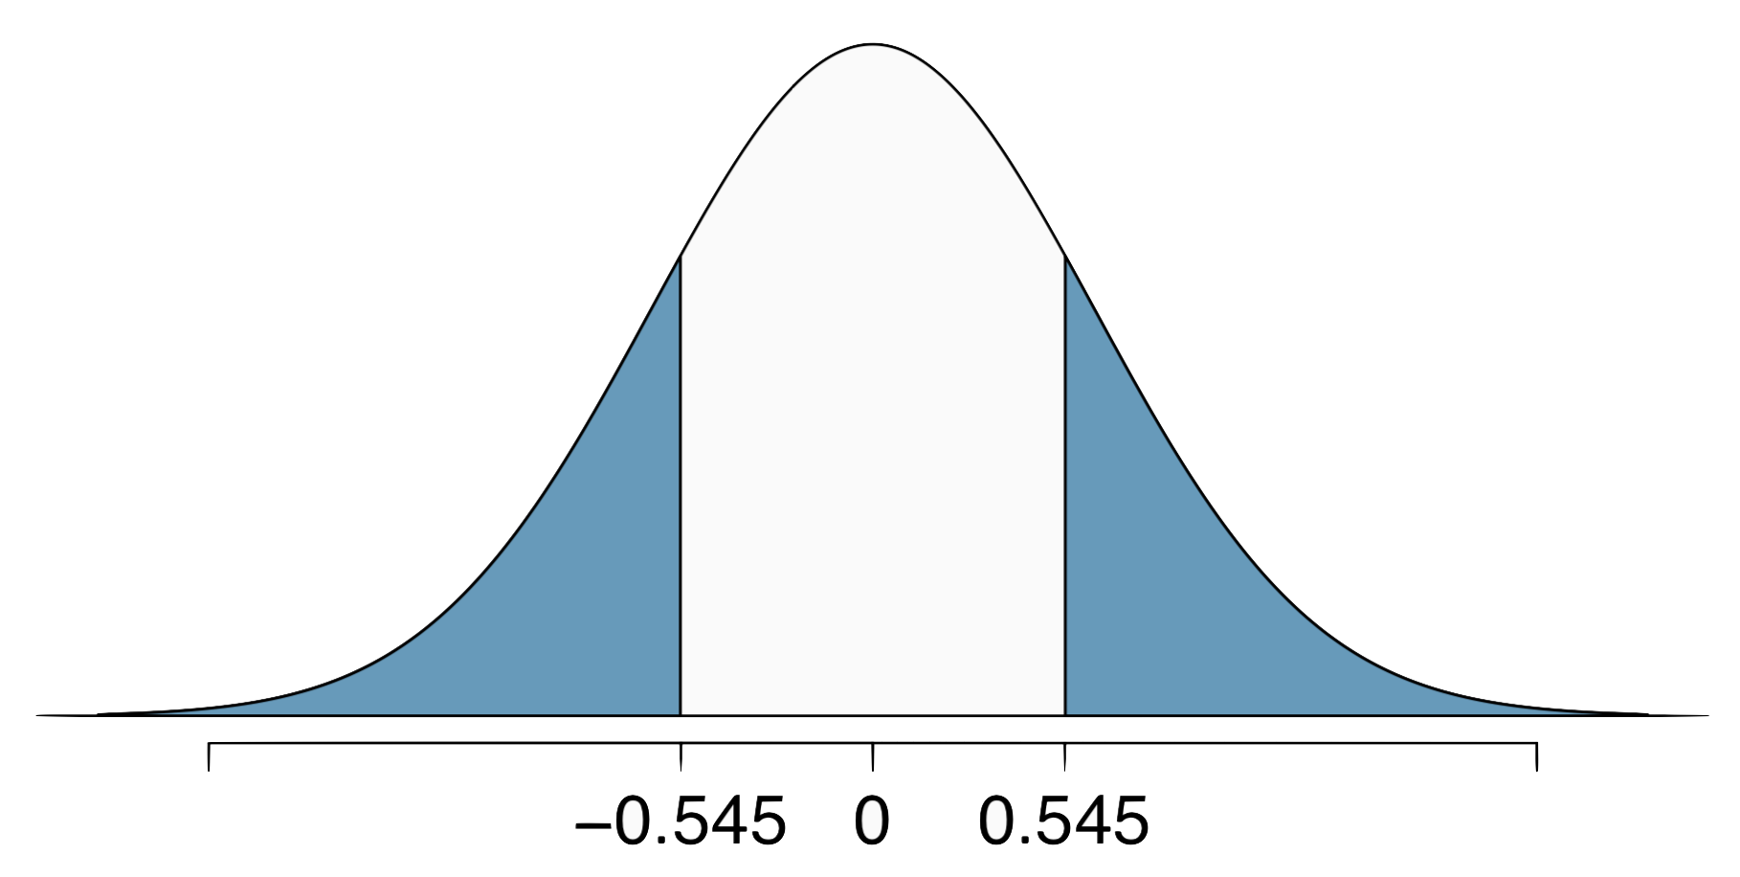
Calculating the test-statistics and the p-value
The observed average difference between the two scores is -0.545 points and the standard deviation of the difference is 8.887 points. Do these data provide convincing evidence of a difference between the average scores on the two exams? Use α = 0.05

Slide 19



Calculating the test-statistics and the p-value
The observed average difference between the two scores is -0.545 points and the standard deviation of the difference is 8.887 points. Do these data provide convincing evidence of a difference between the average scores on the two exams? Use α = 0.05

Slide 20

Calculating the test-statistics and the p-value
The observed average difference between the two scores is -0.545 points and the standard deviation of the difference is 8.887 points. Do these data provide convincing evidence of a difference between the average scores on the two exams? Use α = 0.05

Slide 21
Calculating the test-statistics and the p-value
The observed average difference between the two scores is -0.545 points and the standard deviation of the difference is 8.887 points. Do these data provide convincing evidence of a difference between the average scores on the two exams? Use α = 0.05
Since p-value > 0.05, fail to reject, the data do not provide convincing evidence of a difference between the average reading and writing scores

Slide 22
Interpretation of p-value
Which of the following is the correct interpretation of the p-value?
Probability that the average scores on the reading and writing exams are equal
Probability that the average scores on the reading and writing exams are different
Probability of obtaining a random sample of 200 students where the average difference between the reading and writing scores is at least 0.545 (in either direction), if in fact the true average difference between the scores is 0
Probability of incorrectly rejecting the null hypothesis if in fact the null hypothesis is true

Slide 23
Interpretation of p-value
Which of the following is the correct interpretation of the p-value?
Probability that the average scores on the reading and writing exams are equal
Probability that the average scores on the reading and writing exams are different
Probability of obtaining a random sample of 200 students where the average difference between the reading and writing scores is at least 0.545 (in either direction), if in fact the true average difference between the scores is 0
Probability of incorrectly rejecting the null hypothesis if in fact the null hypothesis is true

Slide 24
HT ↔ CI
Suppose we were to construct a 95% confidence interval for the average difference between the reading and writing scores. Would you expect this interval to include 0?
yes
no
cannot tell from the information given

Slide 25
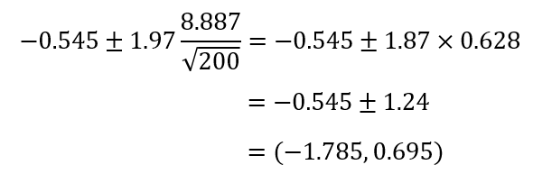
HT ↔ CI
Suppose we were to construct a 95% confidence interval for the average difference between the reading and writing scores. Would you expect this interval to include 0?
yes
no
cannot tell from the information given

Slide 26
Find more resources at openintro.org/os, including
Slides
Videos
Statistical Software Labs
Discussion Forums (free support for students and teachers)
Learning Objectives
Teachers only content is also available for Verified Teachers, including
Exercise solutions
Sample exams
Ability to request a free desk copy for a course
Statistics Teachers email group
Questions? Contact us.

